Slide 1
Please read this before using presentation
This presentation is based on content presented at the industry information session on risk-based hygiene management planning held in May 2015
It is made available for non-commercial use (e.g. toolbox meetings, OHS discussions) subject to the condition that the PowerPoint file is not altered without permission from Resources Safety
Supporting resources, such as brochures and posters, are available from Resources Safety
For resources, information or clarification, please contact:
  RSDComms@dmp.wa.gov.au
  or visit
  www.dmp.wa.gov.au/ResourcesSafety

Slide 2

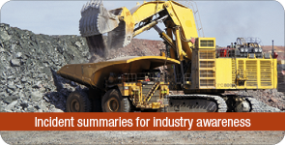
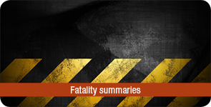
Our commitment
To work with industry to reduce serious accidents and incidents, and provide tangible support in achieving a positive cultural change.

Slide 3
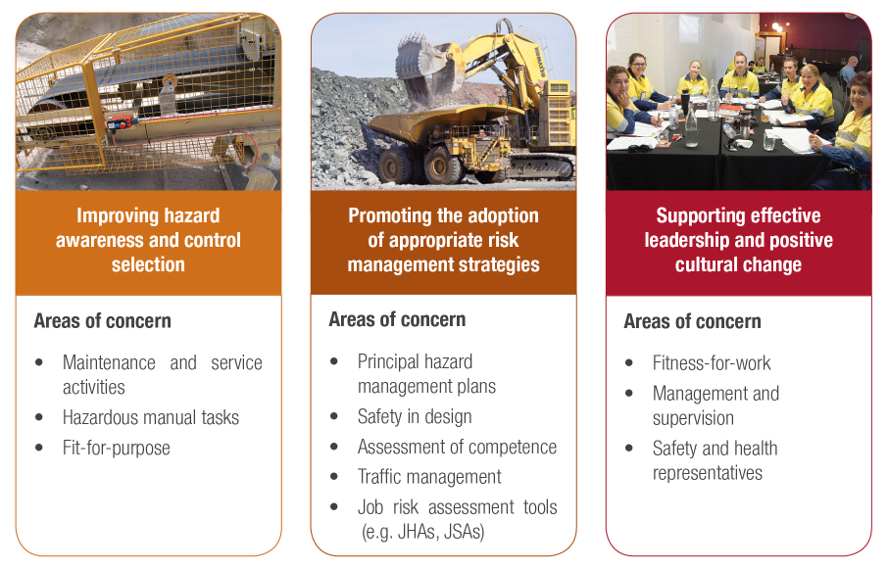
Resources Safety’s focus

Slide 4
Ventilation of underground mines in Western Australia

Slide 5
What are we going to cover?
Existing WA legislation
State of play
Subsidiary material, COPs, standards, alerts, SIRs
Role of industry and the regulator
Prescriptive ventilation requirements
Common deficiencies relating to ventilation management

Slide 6
What are we going to cover?
New WA legislation - Work Health & Safety (Resources) Bill
Timeline for introduction
Safety management system (PHMP, PCP)
Risk management process
Duty holders - principles applicable to duties
Application to ventilation

Slide 7
What are we going to cover?
Ventilation management moving forward
Application of innovative technologies
Working together for effective vent management

Slide 8
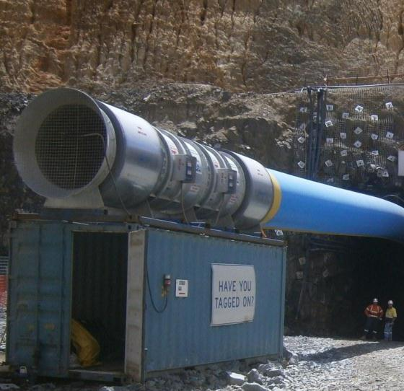
Existing WA legislation

Slide 9
How is safety currently regulated in WA?
WorkSafe WA
Resources Safety
Energy Safety
Energy Safety Act
Occupational Safety and Health Act
General industry safety regulations
Mines Safety and Inspection Act
Petroleum and Geothermal Energy Resources Act
Dangerous Goods Safety Act
DG safety regulations
DG / explosives safety and security
Petroleum safety regulations
Mines Safety and Inspection Regulations
Energy safety regulations
Gas and electrical safety
Occupational health and safety
Workplace hazardous chemicals (excluding DG)

Slide 10

Legislative hierarchy
  IMAGE: https://www.google.com.au/Resource-Safety-Law-Reform-in-WA.

Slide 11
Mines Safety and Inspection Act 1994 and
Mines Safety and Inspection Regulations 1995
Legislation
  Duty of care
  Risk management
  Concept of “reasonably practicable”

Slide 12
Mines Safety and Inspection Act 1994 and
Mines Safety and Inspection Regulations 1995
Application
OSH in mining operations:
  exploration
  surface and underground mines
  certain port activities
  mineral treatment facilities
  construction
Provides a relatively high level of prescription around atmospheric contaminants and ventilation
MSIA and MSIR will continue to be the primary legislation until harmonised legislation is introduced

Slide 13
MSIR - Prescriptive ventilation regulations
Part 7 — Occupational health
    7.27 Risk assessment
    7.28 Means of reducing risk of exposure to hazardous substances
    7.29 Workplace atmospheric contaminant monitoring to be provided
Part 9 — Ventilation and control of dust and atmospheric contaminants
    9.3 Ventilation officer to be appointed
    9.4 Qualifications of ventilation officer
    9.5 Duties of ventilation officer – underground
    9.6 Duties of ventilation officer – surface mining operations
    9.7 Ventilation log book
    9.8 Ventilation system defects to be rectified
    9.11 Exposure standards
    9.12 Control of atmospheric contaminants

Slide 14
MSIR - Prescriptive ventilation regulations (con’t)
Part 9 — Ventilation and control of dust and atmospheric contaminants (con’t)
    9.13 Sampling of atmospheric contaminants
    9.14 Air in underground workplaces
    9.15 Air temperature
    9.16 Air sources
    9.20 Ventilating fans and equipment
    9.28 Ventilation plans for underground mines
    9.29 Monitoring of toxic, asphyxiant and explosive gases
Part 10 — Specific requirements for underground mines
    10.12 Workers to be withdrawn if danger exists
    10.29 Sulphide dust ignitions
    10.51 Specifications and testing of diesel units
    10.52 Ventilating air requirements for diesel unit operation
    10.53 Exhaust treatment devices
    10.54 Undiluted exhaust gas sampling

Slide 15
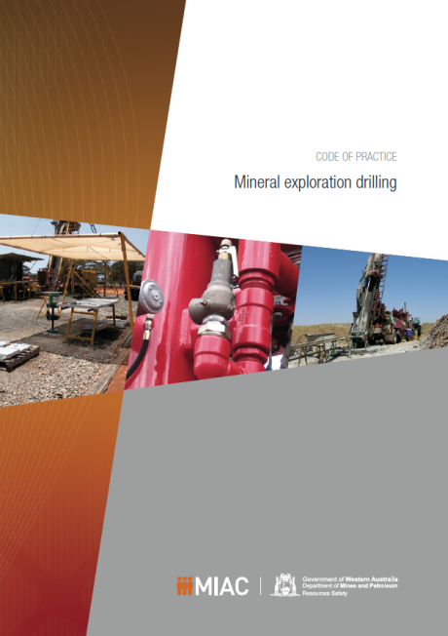
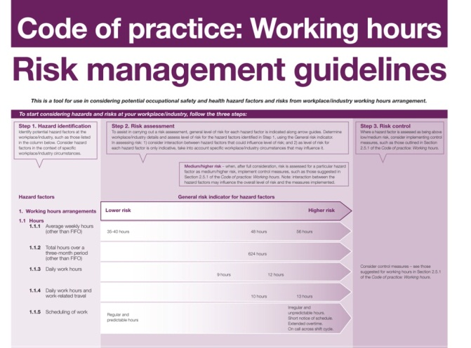
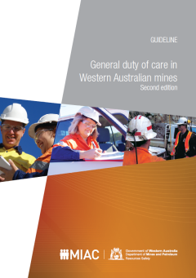
Publications – Codes of practice and guidelines
Mining – endorsed by Mining Industry Advisory Committee (MIAC)
Approved and gazetted by the Minister for Mines and Petroleum
Mining – endorsed by MIAC

Slide 16
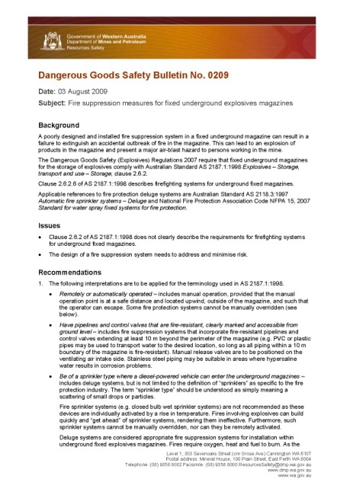
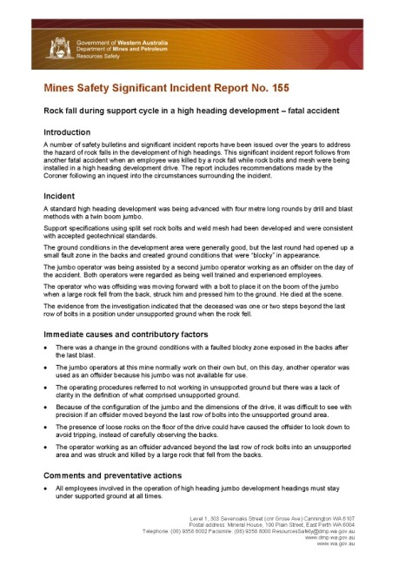
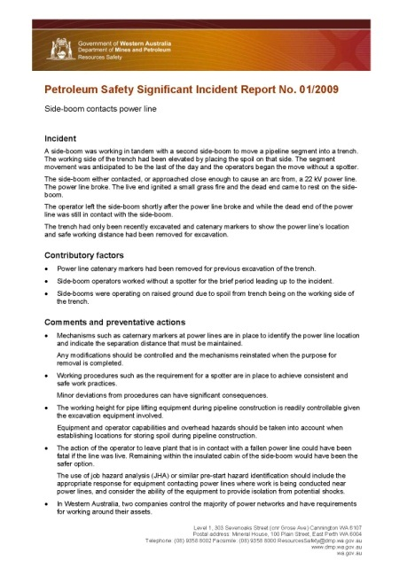
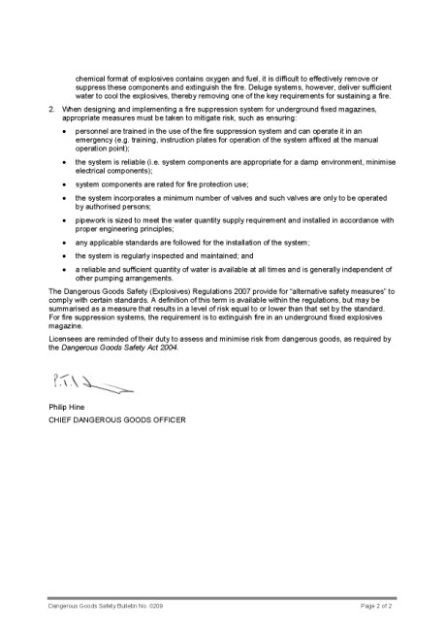
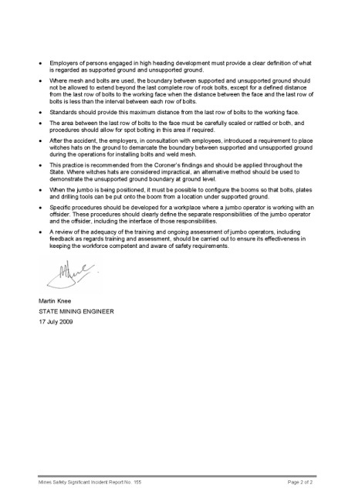
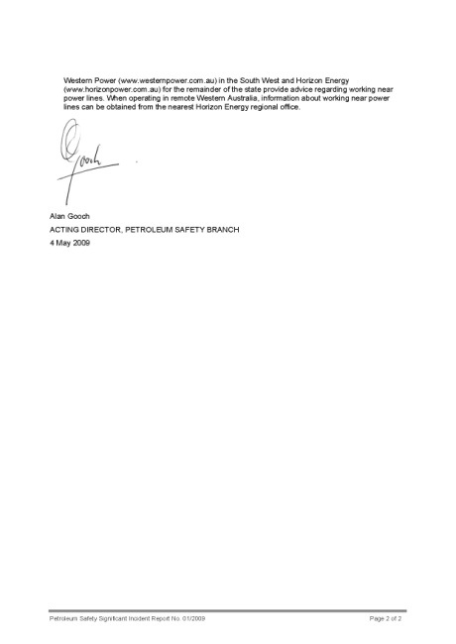
Publications – Safety alerts
Application
Share lessons learnt
Safety Bulletin – covers cluster of similar incidents or industry-wide problem or developing issue
Significant Incident Report – issued for specific incidents with serious or potentially serious consequences
Application

Slide 17
Legislation and guidance
  MSIR applies exposure standards as
  defined by “Adopted National Exposure
  Standards for Atmospheric
  Contaminants in the Occupational
  Environment” [NOHSC:1003 (1995)]
  Numerous references currently exist
  in MSIR to Australian Standards
  (e.g. AS 3640 & AS 2985 Workplace
  atmospheres - Method for sampling
  and gravimetric determination of inhalable /
  respirable dust)
  Safety bulletins, significant incident reports
  IMAGE: https://www.google.com.au/Resource-Safety-Law-Reform-in-WA.

Slide 18
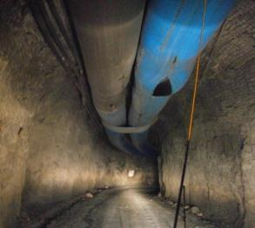
Common ventilation deficiencies
Underground
Competency of vent officers
  Including health & hygiene
Lack of data recorded in vent log books
  Primary, secondary, vent modifications
Multiple branching and lack of choking
Long runs of primary/secondary vent
Inadequate airflow in high temp/humidity
Atmospheric contaminants (DP,CO,CO₂,NOX,SO₂,CH_{4,}H₂S)
Lack of gas monitoring

Slide 19
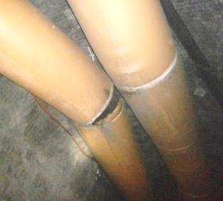
Common ventilation deficiencies
Surface
Gold rooms (NH₃,HCN)
Welding / boilermaker bays
Painting and sandblasting
Dangerous goods / reagents / gas cylinder storage
Laboratories
Dust:
  Processing (crushing), open pit (drilling and haulage), exploration

Slide 20
MSIR 9.4 Qualifications of ventilation officer
(1) To be eligible for appointment as a ventilation officer for an underground mining operation, a person must hold —
(a) a diploma or degree in which mine ventilation was a substantial component of the curriculum; or
(b) a qualification considered by the State mining engineer to be adequate for the mine
(2) To be eligible for appointment as a ventilation officer for a surface mining operation, or as a technician assisting a ventilation officer, a person must —
(a) be trained in the sampling and assessment of atmospheric contaminants; and
(b) demonstrate to the satisfaction of the manager or principal employer that the person is competent to perform the duties of that position

Slide 21
MSIR 9.5. Duties of ventilation officer — underground
(see also MSIR 9.6. for surface ventilation officer)
Regularly inspect and test workplaces to ensure adequate ventilation flows and that atmospheric contaminants are ALARA
At intervals not exceeding 3 months:
  (and after any substantial change) determine and record the quantity and quality of ventilating air in the mine using correct procedures, instruments and equipment
  Record primary fan pressure and volume
  Update mine ventilation plans, have immediately available to emergency response
Operate, calibrate and maintaining instrumentation
Conduct, record and report any atmospheric contaminant sampling requested by an Inspector

Slide 22
MSIR 9.5. Duties of ventilation officer — underground
(see also MSIR 9.6. for surface ventilation officer)
Record the wet and dry bulb temperatures of all workplaces where conditions have potential for adverse effects on the safety and health of persons
Select and position auxiliary fans, regulators and other controls, ensuring that the required volumes of air are provided in workplaces
Report promptly to the manager any defect or deficiency in the ventilation at the mine or any atmospheric contaminant level in a workplace that exceeds the exposure standard
Enter records in the ventilation log book, dated and signed
Provide guidance to any technician employed to assist

Slide 23
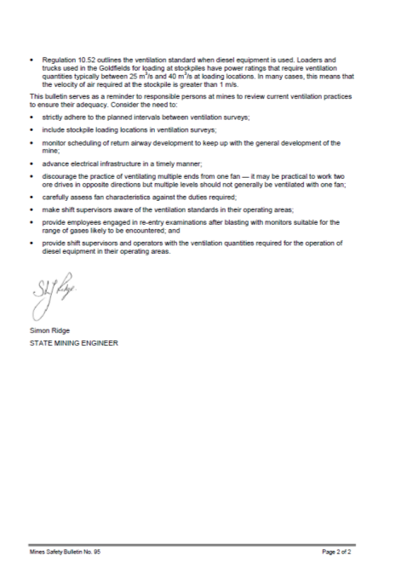
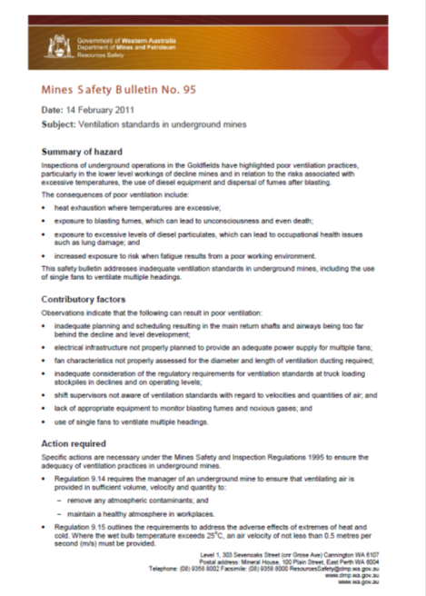
Mines Safety Bulletin no. 95 (2011)
Promotes MSIR 9.14, 9.15, 10.52
Planning and scheduling of:
  ventilation surveys
  return airway development
  advance electrical infrastructure
Suitability of fans
Provision of :
  gas monitors during re-entry
  ventilation quantities required for the operation of diesel equipment in operating areas.
Shift Supervisor awareness of ventilation standards
Discourages the practice of ventilating multiple ends from one fan, particularly multiple levels

Slide 24
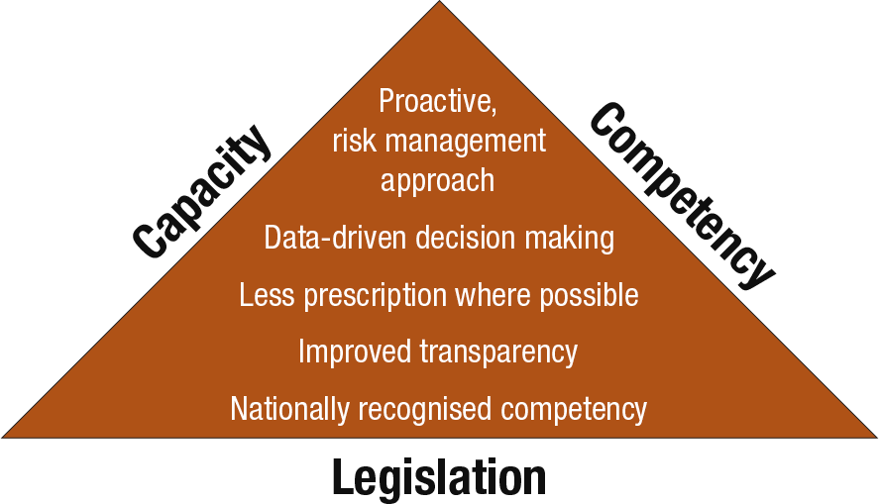
What is the vision for leading practice regulation?

Slide 25
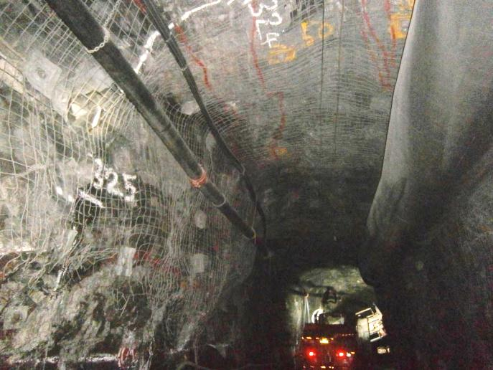
New legislation - Work Health & Safety (Resources) Bill

Slide 26
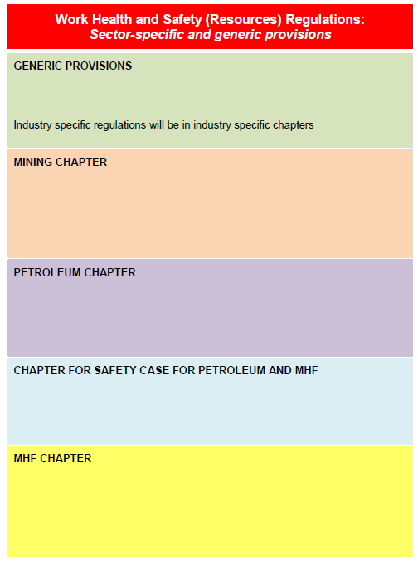
Work Health and Safety (Resources) Act and Regulations* (indicative structure only)
WHS(R) Act – High level generic provisions
WHS(R) Regulations to include:
  Major Hazard Facilities (MHF)
  Petroleum safety & health
Separate Acts and Regulations retained by:
  WorkSafe
    WHS Act
    Consistent with WHS model
  Dangerous Goods
    Major Hazard Facilities (MHF) removed
  Petroleum (3 separate Acts)
    OHS elements removed
Provisions not adopted by Western Australia are workplace entry by WHS entry permit holders, and enforceable undertakings.
* Subject to the outcomes of detailed development and stakeholder consultation

Slide 27
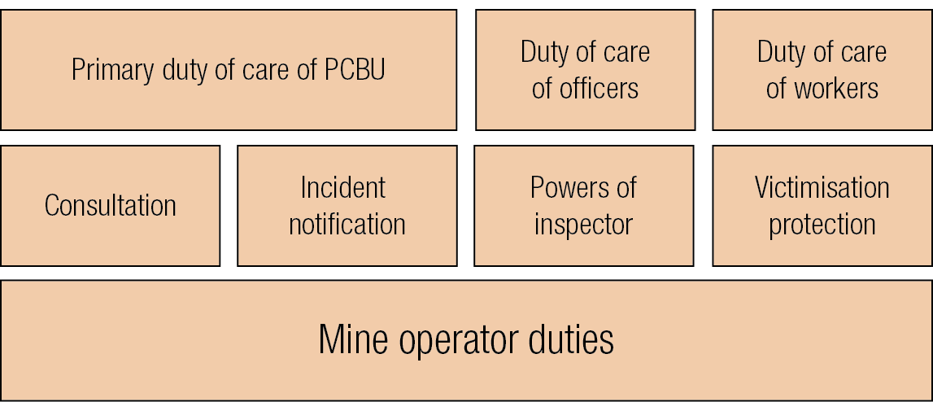
Work Health and Safety (Resources) Act
Work Health and Safety (Resources) Act
PCBU = Person conducting business or undertaking

Slide 28
Where are we up to?
Draft Work Health and Safety (Resources) Regulations
Consultation RIS
Mar – Aug 2016
Work Health and Safety (Resources) legislation
Dec 2016
Consultation Regulatory Impact Statement (RIS)
June - Oct 2015
Draft Work Health and Safety (Resources) Bill

Slide 29
Management and supervision - differences
MSIA | WHS(R)A
Principal employer Registered manager Underground manager; alternate and deputy Quarry manger; alternate and deputy Underground supervisor Ventilation Officer Management appointments Exploration manager Other supervisors (surface and exploration operations) | PCBU – Duties of mine operator Duties of Site Senior Executive Other prescribed positions: Exploration Underground Surface

Slide 30
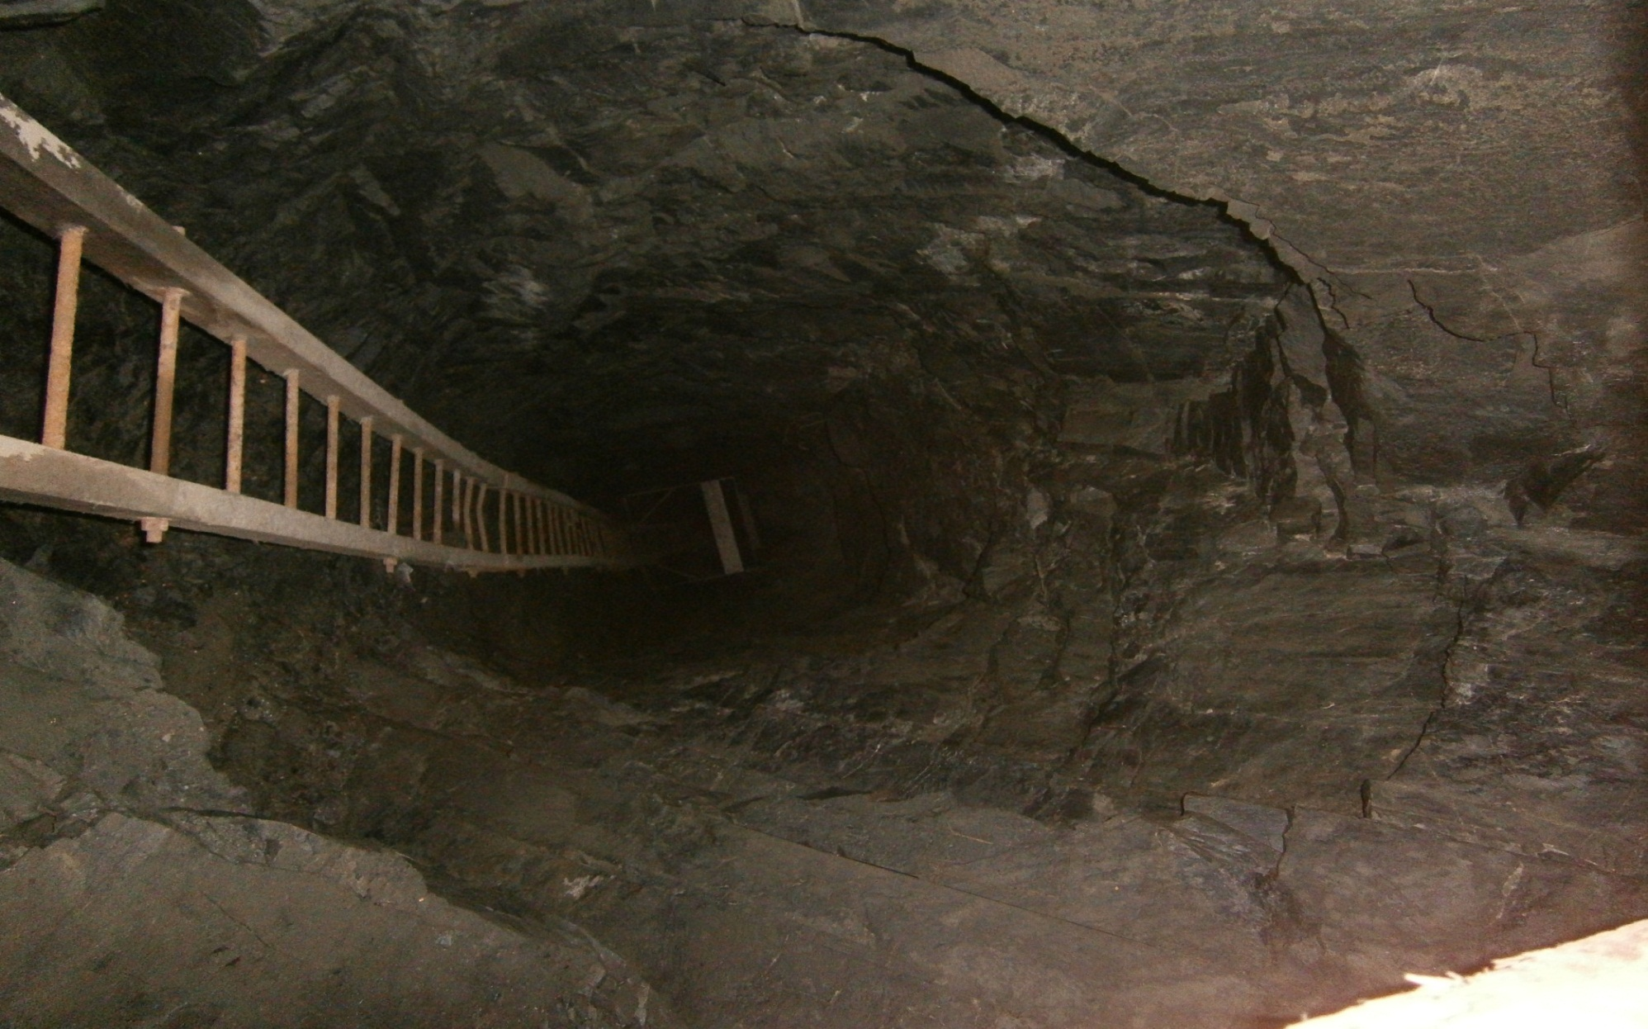
Duty of officers
There is a positive duty on officers of the PCBU to exercise “due diligence” to ensure that the PCBU complies with any duty or obligation under the Act.
The positive duty requires officers to be proactive
Included in duties of an officer:
  Acquiring and keeping up-to-date knowledge of work health and safety matters
  Ensuring the PCBU has, and implements, processes for complying with any duty or obligation placed on the PCBU
  Duty to consult with other duty holders
  Duty to consult with workers
Duty is not transferrable
Obligations cannot be contracted out

Slide 31
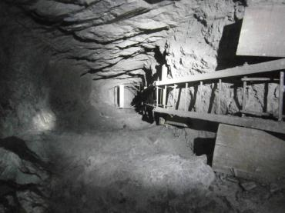
Roles in risk management process
Duty holder must:
Identify all reasonably foreseeable hazards
Eliminate risks – so far as is reasonably practicable
If above not possible, minimise those risks – so far as is reasonably practicable
A person conducting a business or undertaking must ensure, so far as is reasonably practicable, the health and safety of:
workers engaged, or caused to be engaged by the person; and
workers whose activities in carrying out work are influenced or directed by the person, while the workers are at work in the business or undertaking.

Slide 32
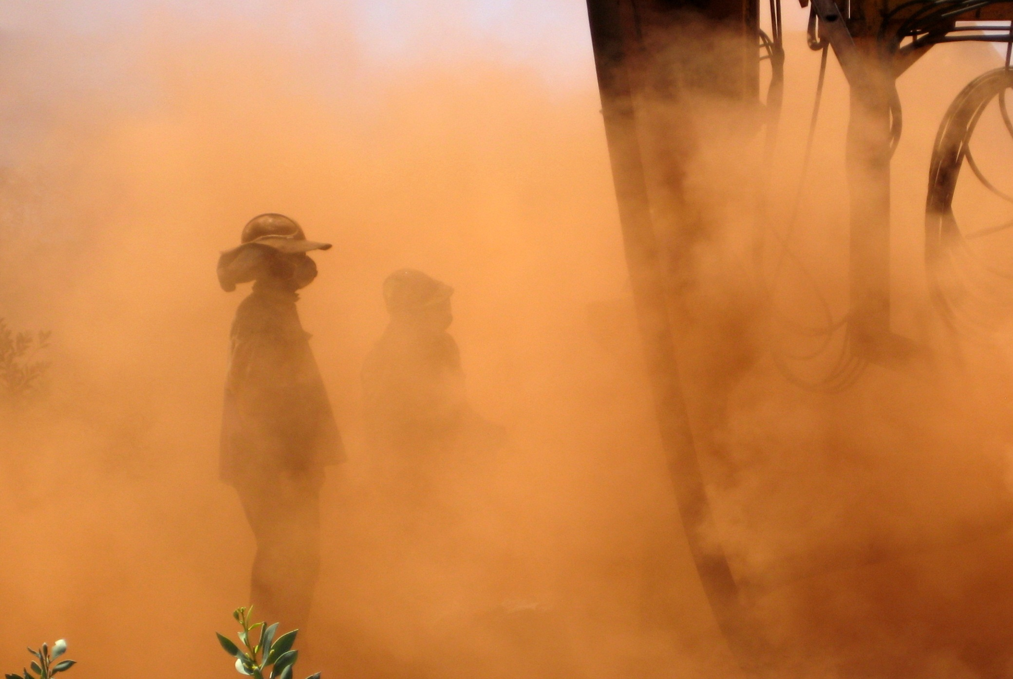
What is reasonably practicable?
At a particular time
Having regard to
  Degree of harm/severity
  Likelihood of potential injury or harm related to the hazard
State of knowledge of (knows or ought to know):
  hazard or the risk
  potential for injury or harm
  likelihood of occurring
  means of eliminating or minimising the risk, and
Availability and suitability of methods
Cost of means (grossly disproportionate to the risk)

Slide 33

Duty holder and control measures
Duty holder must ensure that control measure is maintained so that it is, and remains effective, and is:
fit for purpose
suitable for nature and duration of work
installed, set up, and used correctly
Duty holder must review and as necessary revise control measures to maintain, so far as is reasonably practicable, work environment without risk
IMAGE SOURCE: http://www2.gnb.ca/content/gnb/en/departments/attorney_general/acts_regulations.html

Slide 34
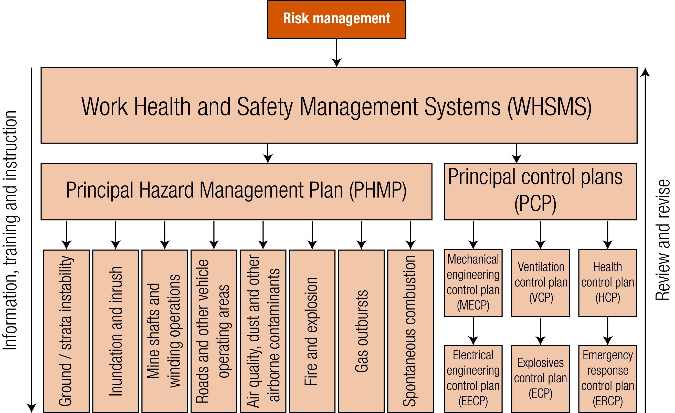
WHSMS / PHMP / PCP

Slide 35
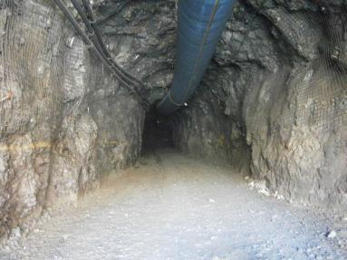
Safety Management System (SMS)
Mine operator must establish and implement SMS
SMS must be used as primary tool to manage health and safety risks by mine operator
No mining operations to take place without SMS established and implemented
SMS to deal with current operations
SMS must be appropriate to mining operations depending on:
  nature
  complexity
  location

Slide 36
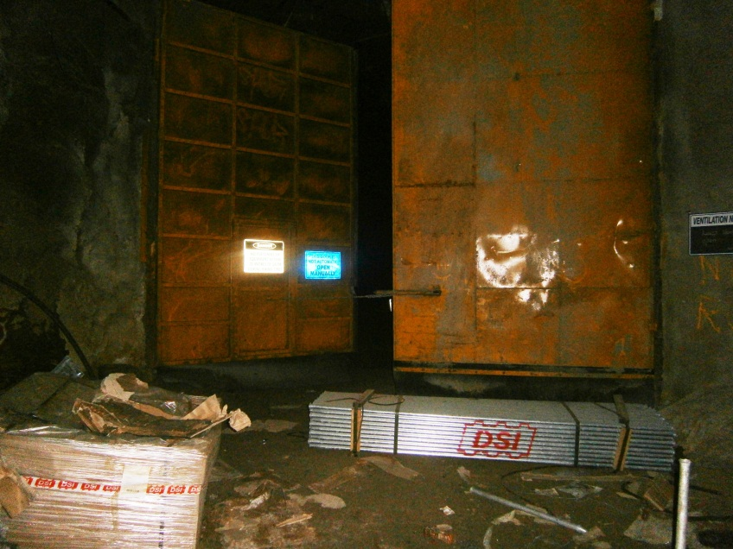
SMS requirements
SMS must be:
A comprehensive and integrated system to manage all risks associated with the mine and mining operation
Developed and maintained in consultation with relevant employees
Documented and be part of mine records
Measured for effectiveness
Maintained to remain effective
Reviewed:
  within first 12 months of commencement for new mines
  once every 3 years or as necessary

Slide 37
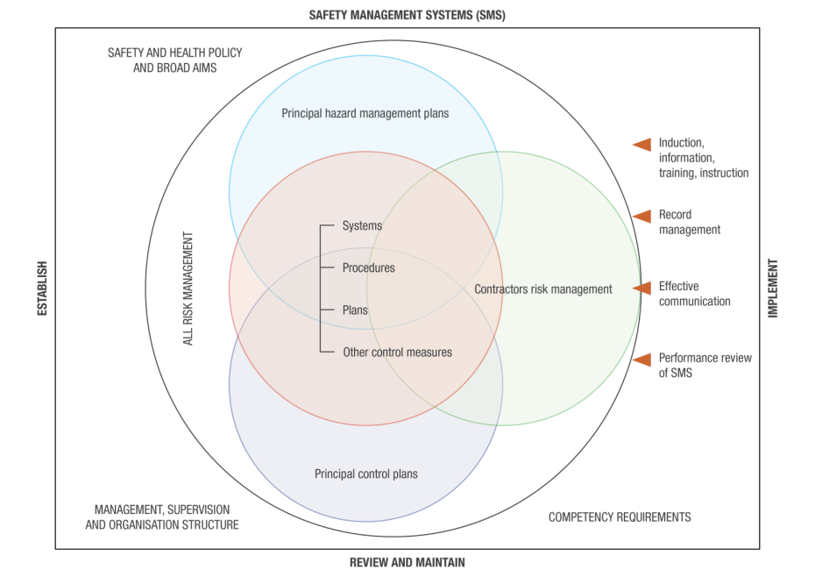

Slide 38
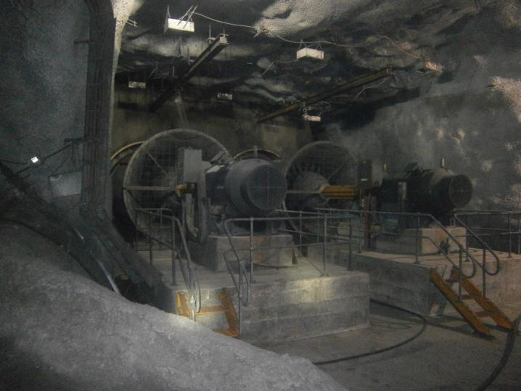
Ventilation management moving forward

Slide 39
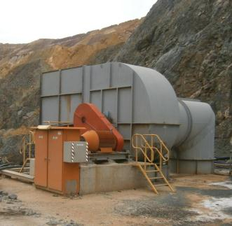
Continued compliance with existing legislation
Current legislation will remain until at least end of 2016
Requirements of MSIA continue to apply
S. 9(1) Provide and maintain workplaces, plant, and systems of work of a kind that, so far as is practicable, the employer’s employees are not exposed to hazards

Slide 40
Ventilation management
An obligation placed on PCBUs to:
  identify principal hazards, including ventilation and develop Principal Hazard Management Plans
  exercise “due diligence” through consultation, representation and participation
  risk assess and implement effective controls
  identify all reasonably foreseeable hazards
  eliminate risks – so far as is reasonably practicable
  maintain, monitor and review controls

Slide 41
Ventilation management (con’t)
Principal Control Plans to be developed and implemented
  Ventilation Management Plan
  Diesel Emissions Management Plan
  Risk Based Occupational Hygiene Management Plans (Health)
  Fibrous Minerals Management Plan

Slide 42

Innovative technological future
Optic fibre communication capability
Enables real-time analysis:
  Equipment and personnel movement
  Machinery emissions monitoring
  Personal exposure monitoring
  Ambient fixed position environment monitoring
  Ventilation flows
  Temperature, humidity, DP, CO, CO₂, NOX, SO₂, CH₄, H₂S
Ventilation on demand (VOD)
Innovation by design – future developments

Slide 43
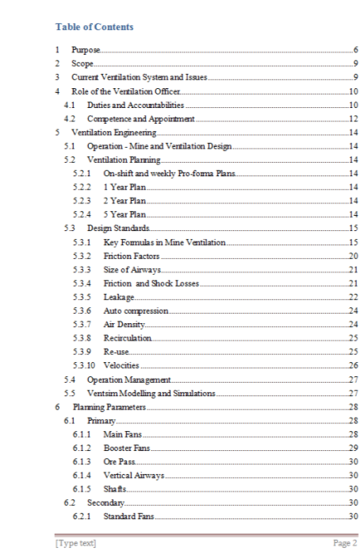
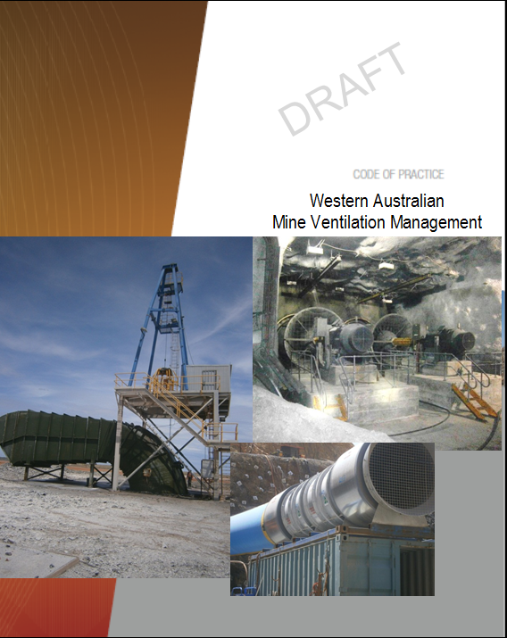
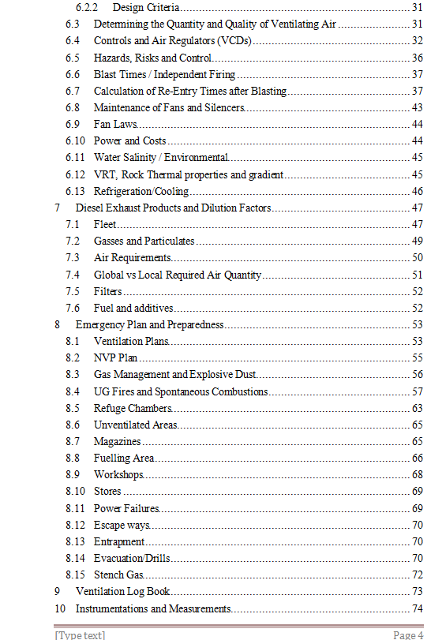
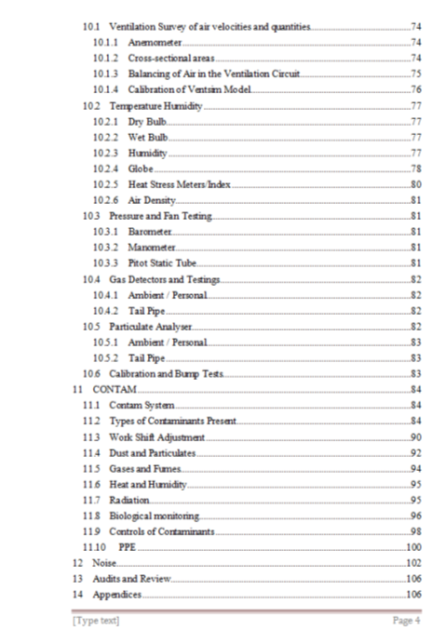
WA Mine Ventilation Management
New Code of Practice
In development – seeking industry involvement

Slide 44


Stay informed!
Subscribe to our email alert service
and receive weekly news about:
recent publications
latest safety alerts
events
what’s happening at Resources Safety.
Visit www.dmp.wa.gov.au/ResourcesSafety
to sign up

